Slide 1

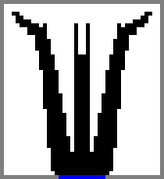
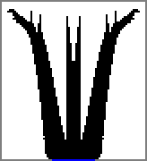
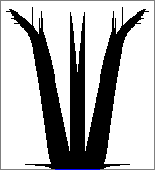
Converged ?
Converged ?
Converged ?
x2
x2
x2
Very coarse
Coarse
Fine
Very fine
Heating poorly-conductive elements
Heat sink elements
Non-heating highly-conductive elements
Adiabatic elements to close the system

Slide 2

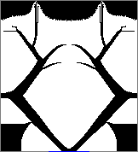

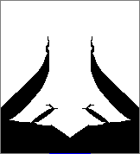
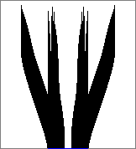
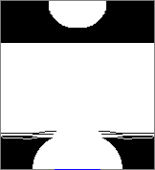
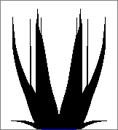
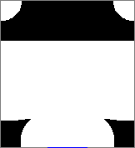
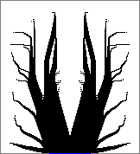
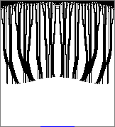
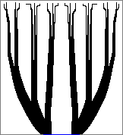
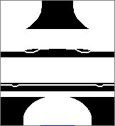
Minimization of entropy variance
Maximization of entropy variance
Minimization
of total entropy
Maximization
of total entropy
Minimization of temperature variance
Maximization of temperature variance
Minimization
of total temperature
Maximization
of total temperature
Minimization of
gradients variance
Maximization of
gradients variance
Minimization
of total gradients
Maximization
of total gradients

